Slide 1





Prediction Salary Using Machine Learning
Data Scientist
INSPIRED BY LM YUDHY PRAYITNO

Slide 2





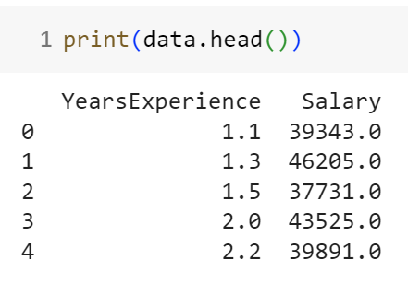





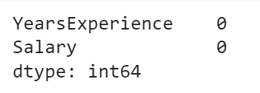

Data Exploration
salary data.csv
Checked for missing data using

Slide 3




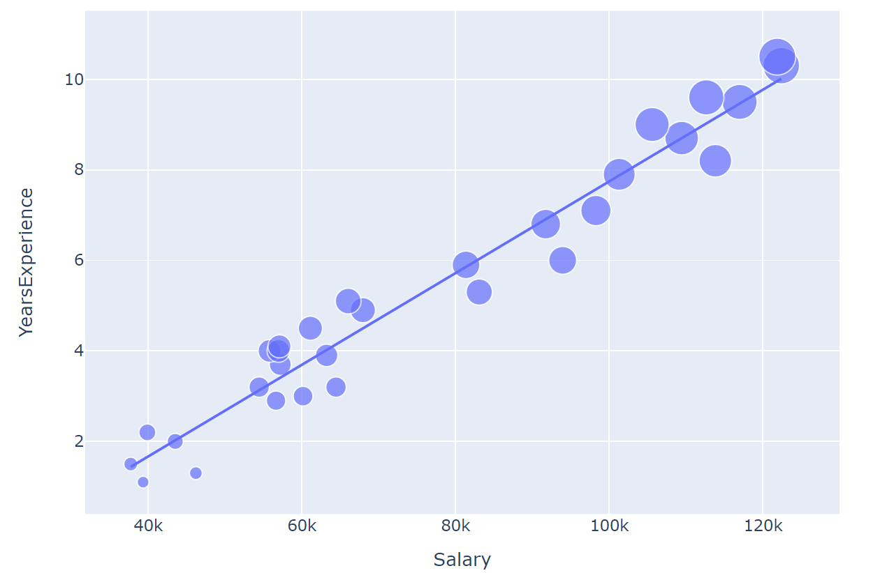




Scatter Plot
Display the scatter plot showing the relationship between salary and years of experience using Plotly.

Slide 4

Linear Regression Model
Linear Regression is a statistical method used to model the relationship between a dependent variable and one or more independent variables.
TRAIN-TEST SPLIT:
MODEL TRAINING:
Utilized the train_test_split function from scikit-learn to partition the dataset into training and testing sets.
This process involves adjusting the model's parameters to minimize the difference between predicted and actual values.
The trained model becomes capable of making predictions based on new input data.

Slide 5



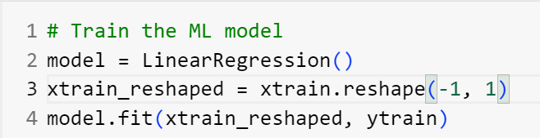

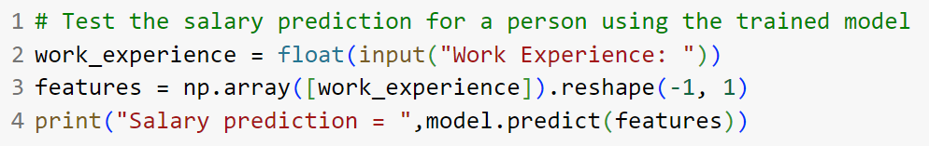


Model Training Code, Predicting Salary

Slide 6


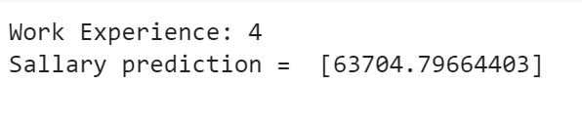

Demo
The conclusion is that the trained linear regression model predicts that an individual with 4 years of work experience may have a salary of approximately $63,704.80, based on the observed relationship between work experience and salary in the data used to train the model.

